Slide 1
ONLINE FOOTBALL LIVE UPDATE
Project by-
Fahim Shahriar Anik
1605065
Shovito Barua Soumma
1605066

Slide 2
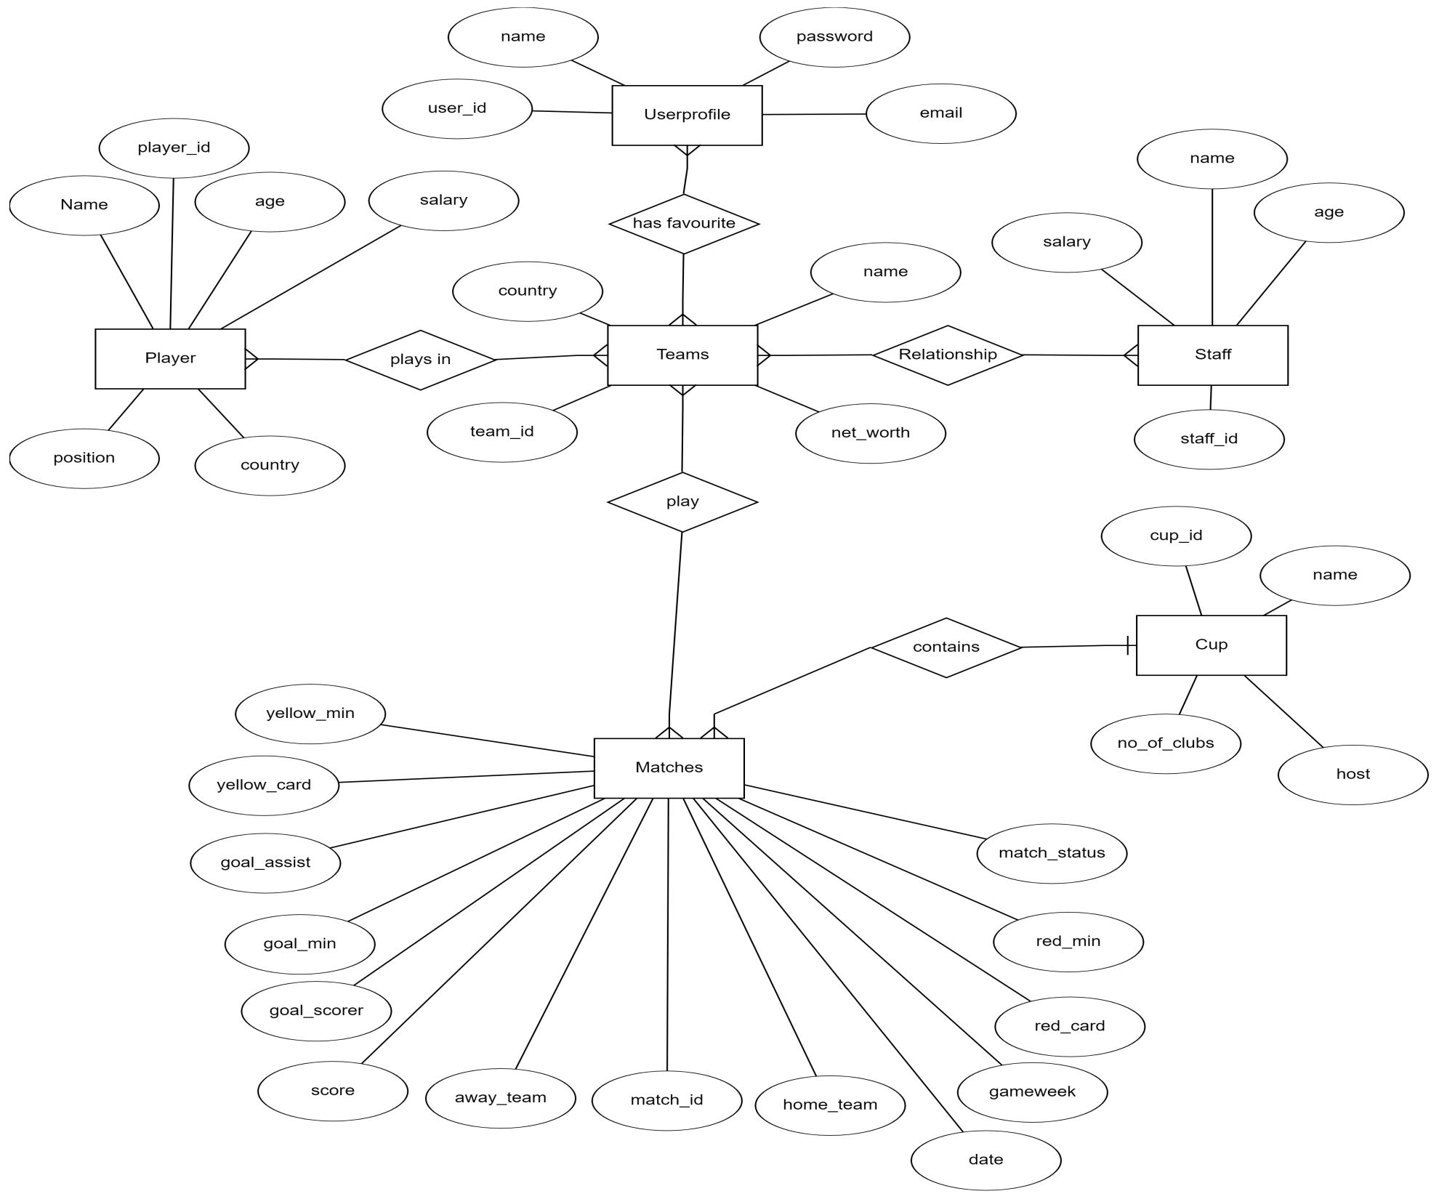
ERD

Slide 3
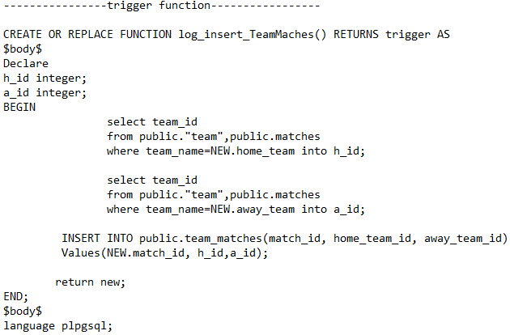
Trigger
We have 3 triggers
insert_teamMatches : If a new match is added in Matches Table this trigger automatically update the relational table (team_matches)
CREATE TRIGGER insert_teamMatches
AFTER INSERT
ON public.matches
FOR EACH ROW
EXECUTE PROCEDURE log_insert_TeamMatches();

Slide 4
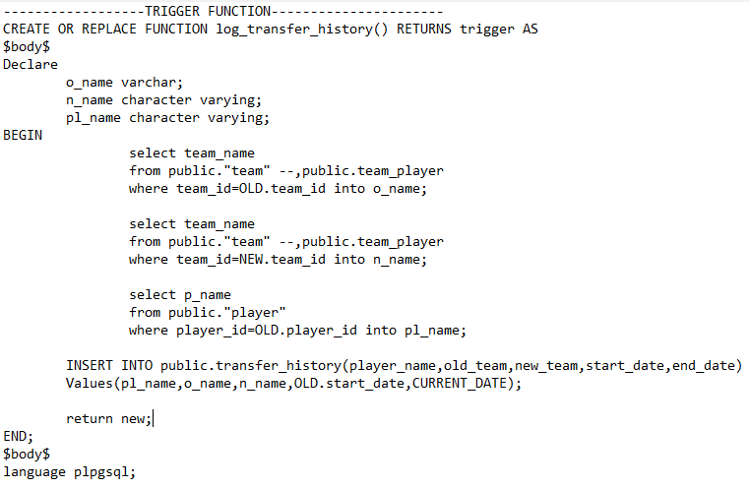
Trigger
2. transfer_history: If we transfer a player from one team to another team ( Update teamID on team_player table ) then this trigger will automatically record the transfer history
CREATE TRIGGER transfer_history
AFTER UPDATE
ON public.team_player
FOR EACH ROW
EXECUTE PROCEDURE log_transfer_history();

Slide 5
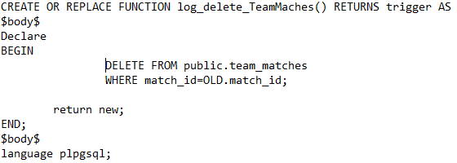
Trigger
3. delete_teamMatches: Perform the opposite action of insert_teamMatches trigger. If a match is deleted from Matches Table this trigger automatically delete the value from the relational table (team_matches)
CREATE TRIGGER delete_teamMatches
AFTER DELETE
ON public.matches
FOR EACH ROW
EXECUTE PROCEDURE log_delete_TeamMatches();

Slide 6
Function
1. Generate_league_standing(cupId): takes a cupid as input and generates the leader table including all teams of that cup/league
Sub Function:
How_many_matches_played(team_name)
How_many_matches_won(team_name)
How_many_matches_drawn(team_name)
How_many_matches_lost(team_name)
How_many_goals_for(team_name)
How_many_goals_against(team_name)
Count_points(win,draw)

Slide 7
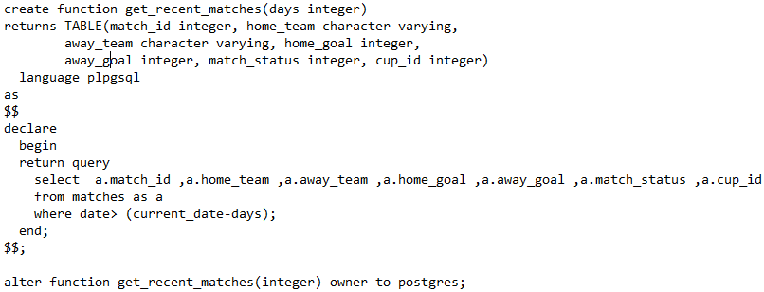
2. get_recent_matches(): Returns a table with match details which are being played now.

Slide 8
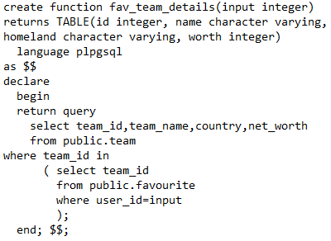
Function
3. fav_team_details(userid): takes user id as input and returns a table containing information about all the favourite team of that users.

Slide 9
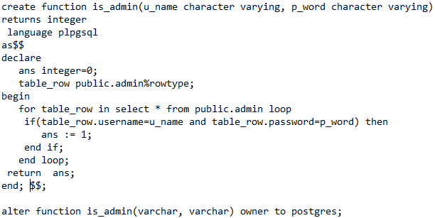
Function
4. is_admin(userName,Password): checks if the person trying to login is an admin

Slide 10
Simple Query(4)
1)---retrieves team details whose net worth is greater than 200000---
SELECT *
FROM public."team"
where net_worth>=200000
2)---takes every country and average of net_worth of teams there--
select country,ROUND(AVG(net_worth),2) Average_Worth
from live."team"
group by country
order by AVG(net_worth) DESC;

Slide 11
Simple Query
3)-------------- Average salary of staff table.------------
select AVG(salary)
from public."staff“
4)------------ players from brazil---------
select *
from public."player" as a
where a.country='Brazil'

Slide 12
Complex Query
1----gives information of those staffs whose salary is higher than the average salary of staff table.-------
select *
from public."Staff"
where salary >=(
select AVG(salary)
from public."Staff")
order by salary DESC;
2---------- shows every team with number of users having this team as favourite
select
b.team_name,count(a.user_id)
from public."team" as b
inner join public."favourite" as a on b.team_id=a.team_id
group by b.team_name
order by b.team_name;

Slide 13
Complex Query
3---shows every user's name, their favourite team's id and name ----
select
a.name,b.team_id as favourite_team,(
select team_name
from team where team_id=b.team_id) as favourite_team_name
from public."userprofile" as a
left outer join public."favourite" as b ON a.user_id=b.user_id
order by a.user_id;
4--------------- finds players who get the highest salary-------------
select *
from public."player"
where salary=(select max(salary) from public."player");

Slide 14
Complex Query
5-------shows every team with it's players-------
select
a.team_id,a.team_name,(select p_name from public."player" where player_id=b.player_id) as Player_name
from public."team" as a
inner join public."team_player" as b on a.team_id=b.team_id
order by a.team_id;

Slide 15


